Slide 1

University Project (PIP102) – 2nd Review Presentation on
FAKE CURRENCY DETECTION
Submitted to the Presidency University, Bengaluru in partial fulfillment of the requirements for the Degree of BACHELOR OF TECHNOLOGY in ELECTRONICS AND COMMUNICATION ENGINEERING
BY
Mr. SAGI RISHIKESH |  | ID No.: 20191ECE0268
Mr. RITHIK S |  | ID No : 20191ECE0263
Mr. SALIPELA VASUDEVA REDDY |  | ID No : 20191ECE0273
Mr. S SHASHANK |  | ID No : 20191ECE0267
Under the supervision of
Ms. SAMREEN FIZA
Assistant Professor
Department of Electronics and Communication Engineering
March, 2023

Slide 2
Content
1. Introduction
2. Objectives
3. Methodology / Plan of Work
4. Work Done
5. Results and Discussions
6. Conclusions
7. References
8. Acknowledgement

Slide 3
Introduction
A large number of counterfeit notes causes economic instability.
But since sorting technology does not take into account the complexities of security features, physical and chemical properties of papers, inks, resins, chemicals, and other materials used to print the notes, it is frequently unable to distinguish subtle differences between fake and genuine notes.
Currency note counterfeiting threatens the existence of the monetary equilibrium by affecting its value, velocity, output, and welfare. This is a problem in most countries that use paper currency for transactions.
Existing methods for detecting and confirming fake notes are inefficient because they require filing a case with the police, sending the document for verification, and then waiting for the results.
This project focuses on a straightforward, efficient, and highly accurate approach to system design. Different dimensions, areas, Euler numbers, and correlations are taken into account when designing such a system.
A digital camera is used to capture the image of the banknote. The acquired image is processed utilizing ideas such image segmentation, edge information extraction, and HAAR feature extraction.
This tries to provide a fully automated method for detecting counterfeit currency notes.

Slide 4
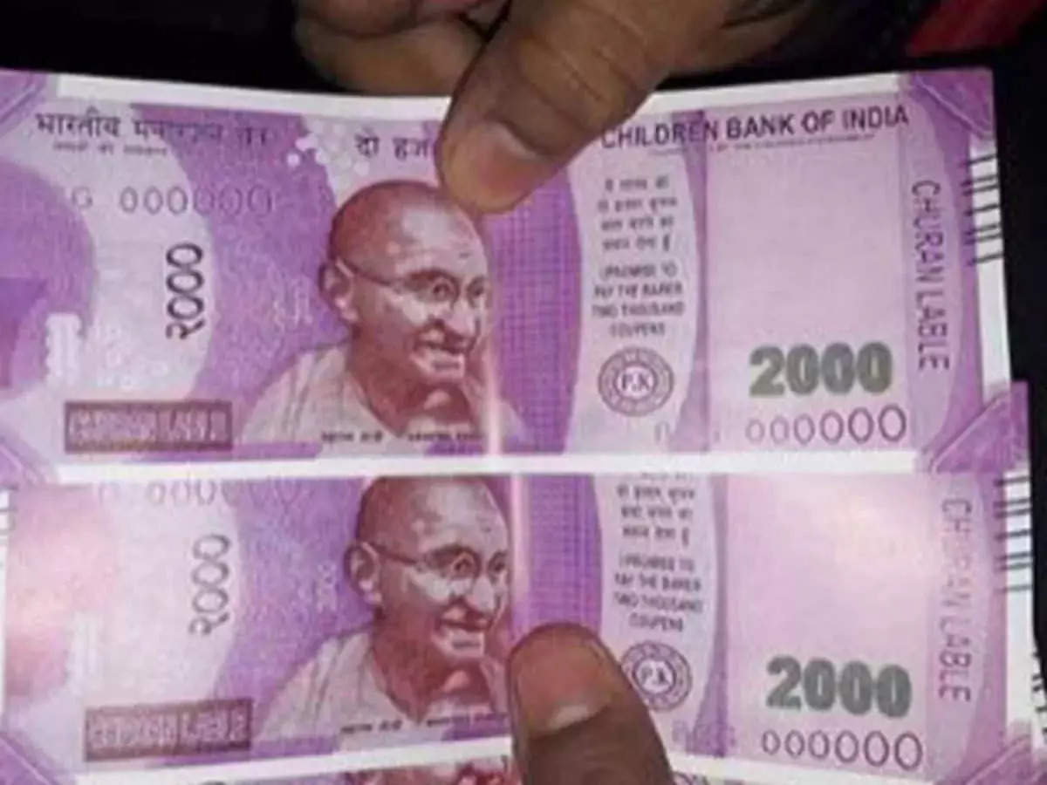
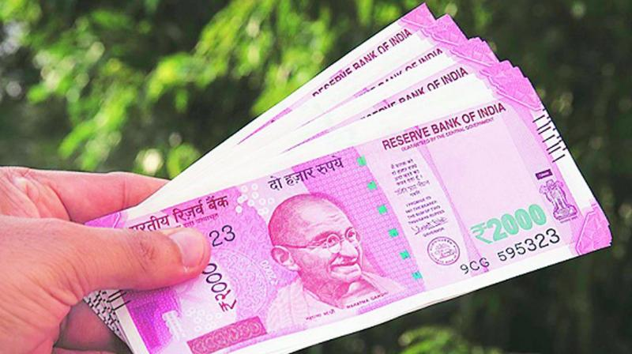
Objectives
The primary goal of the project is to automatically detect counterfeit money notes.
Creating a feature localization method, a feature extraction and recognition system, and an optical character recognition system for value detection.
To boost accuracy rates(existing 82%) for identifying counterfeit cash notes.
And ultimately, to cease using these fake bills, eradicate them completely, and strengthen the nation's economy.
Fake Indian Currency
Real Indian Currency

Slide 5
Methodology / Plan of Work
In currency recognition, we use image processing to identify and isolate the currency's denomination. In this section, we are extracting the acquired image's features. The recommended steps are being followed:
IMAGE ACQUISITION
PRE - PROCESSING
CANNY - EDGE DETECTION
IMAGE SEGMENTATION
FEATURE EXTRACTION

Slide 6
Methodology / Plan of Work
The validity of the currency is checked or authenticated during currency verification. Here, we extract the currency's texture features, compare them to the stored characteristics, and finally generate the output. We use steps for the method described above:
IMAGE ACQUISITION
PRE - PROCESSING
FEATURES EXTRACTION
FEATURE COMPARISON

Slide 7
Work Done
We have finished our research of the literature on fake currency identification and have located the key details. These key points are provided.
The method was proposed to compare photographs of currency with the stored data and detect whether the currency is false or genuine because no one can be completely certain of the manual recognition. This system's operations were conducted and completed using MATLAB. As the image is broken into blocks and operations are carried out on the ROI, the feature extraction procedure mostly concentrates on HSV values of the currency.
In the survey study, a system is suggested for enhancing the cash detection system, particularly in commercial settings like banks and shopping centres. Here, various pre-processing methods including radiometric corrections and geometric corrections for spectrum inaccuracies or distortions caused by sensor-Earth geometry differences, etc., were mentioned. Several studies were compared, and outcomes based on the accuracy rate attained using various techniques were presented.
A technique is suggested to identify counterfeit money using various features that may be retrieved and compared. At various phases of histogram equalisation, several techniques are utilized, such using feature vectors to store extracted features, etc. Security thread, RBI micro-print, and serial number detection were the features that were utilised for currency detection.

Slide 8
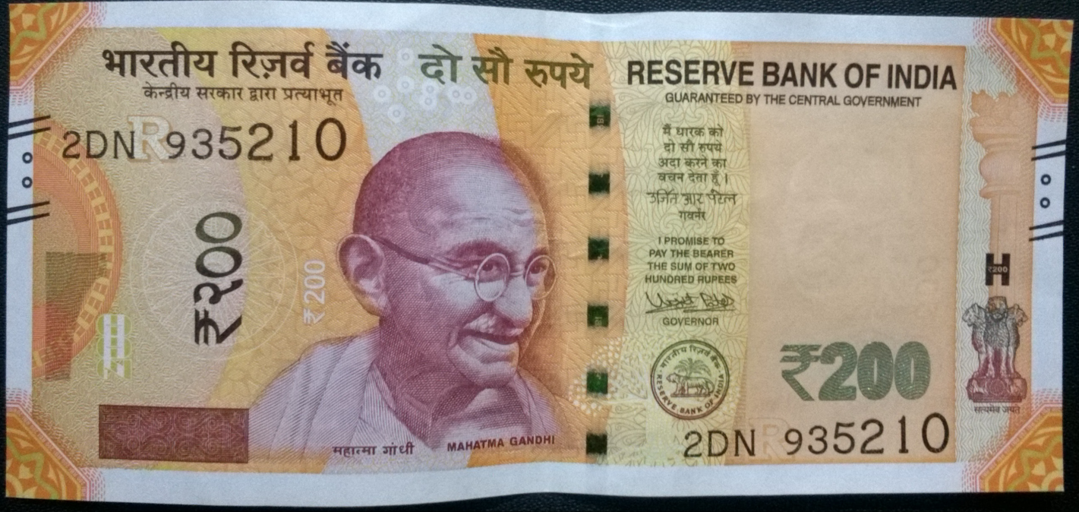
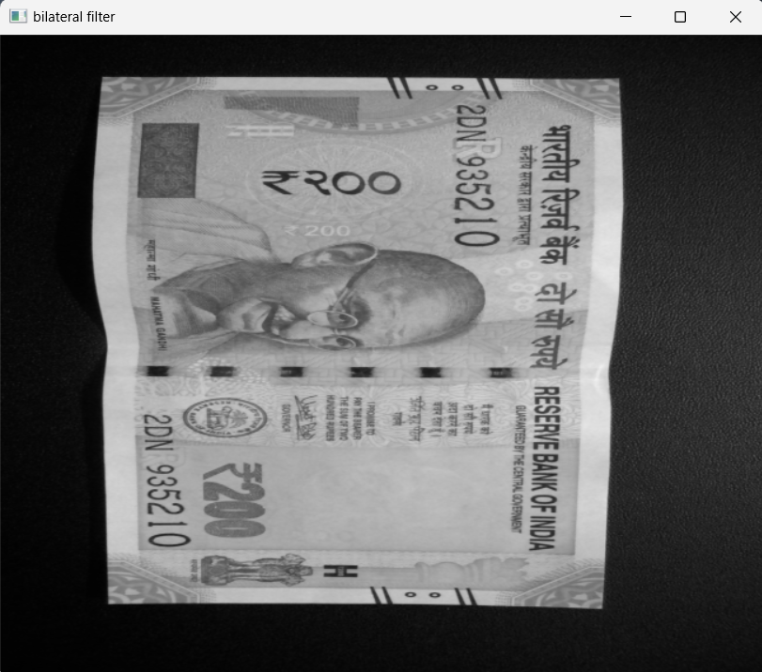

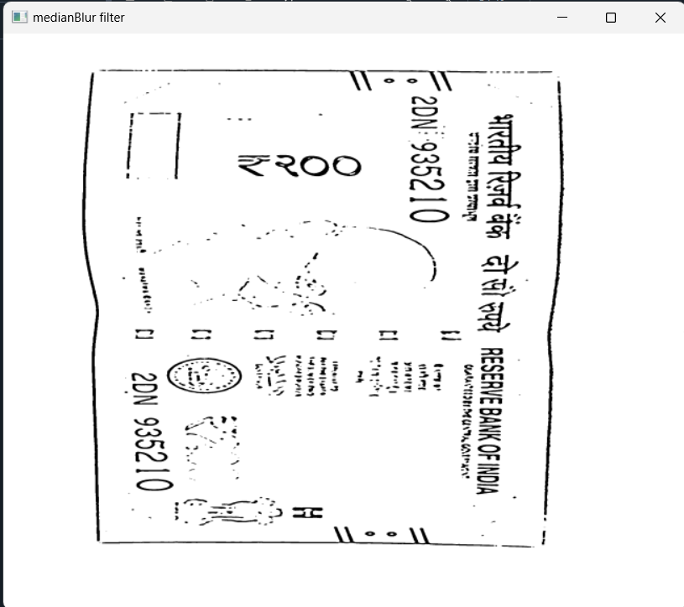
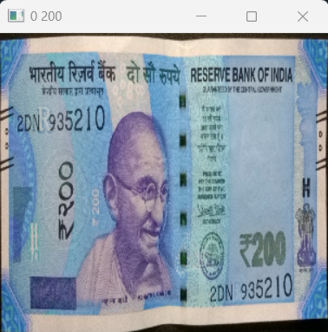
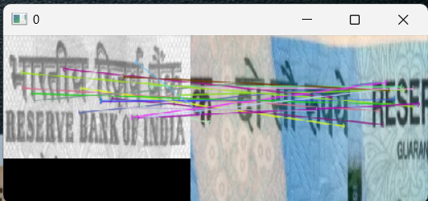
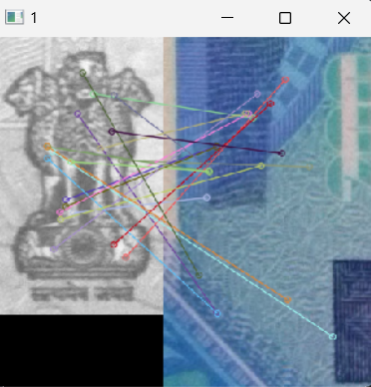
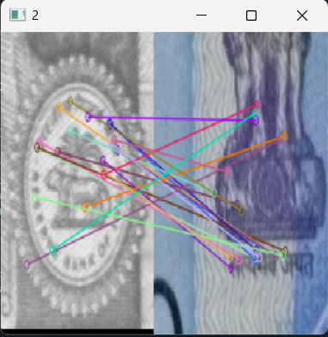
Work Done
The full code has been executed, and the required results have been obtained.
The results for a few of the tests are provided below.
IMAGE ACQUISITION
PRE - PROCESSING
EDGE DETECTION
IMAGE SEGMENTATION AND COMPARISON

Slide 9
Results and Discussions (If Any)
We have finished our research of the literature on fake currency identification and have located the key details.
The full code has been executed, and the required results have been obtained.

Slide 10
Conclusions
Digital image processing improves the accuracy and efficiency of currency image analysis while also being less expensive and time-consuming than other methods. The amount of research being done in this area is growing daily, and various image processing techniques are being used to produce results that are more accurate. The suggested approach successfully extracts a feature from photos of banknotes. The currency image's extracted features will be used for both currency value recognition and currency value verification. Application-based system shall be created to achieve a proper result whether currency image is fake or it's genuine.

Slide 11
References
Muhammad Sarfraz, “An intelligent paper currency recognition system”, International Conference on Communication, Management and Information Technology (ICCMIT 2015), doi: 10.1016/j.procs.2015.09.128
Ankush Roy, Biswajit Halder, Utpal Garain, David S. Doermann, “Machine-assisted authentication of paper currency: an experiment on Indian banknotes”, May 2015, DOI 10.1007/s10032-015-0246-y
Brindha M “Object Detection using Haar-Like Feature Extraction “International Journal of Computer Applications (0975 – 8887) Volume 153 – No 9, November 2016.
IOP Conference Series: Materials Science and Engineering, “Fake currency detection using image processing”, Tushar Agasti, 2017, Scopus;doi:10.1088/1757-899X/263/5/052047
M.A. Zamalloa Jara, C. Luízar Obregón, C. Araujo Del Castillo, “Exploratory analysis for the identification of false banknotes using portable X-ray Fluorescence spectrometer”, Elsevier, doi: 10.1016/j.apradiso.2018.01.043
SangwookBaek, EuisonChoi, YoonkilBaek, ChulheeLee, “Detection of counterfeit banknotes using multispectral images”, Elsevier, doi:10.1016/j.dsp.2018.03.015
A. Vila, N. Ferrer, J. Mantecon , D. Breton , J.F. Garcıa, “Development of a fast and non-destructive procedure for characterizing and distinguishing original and fake euro notes”, Elsevier, doi: 10.1016/j.aca.2005.11.084
Aman Bhatia, Vansh Kedia, Anshul Shroff, Mayand Kumar, Bickey Kumar Shah, Aryan, “Fake Currency Detection with Machine Learning Algorithm and Image Processing”, IEEE, doi:10.1109/ICICCS51141.2021.9432274
Kamesh Santhanam, Sairam Sekaran, Sriram Vaikundam, Anbu Mani Kumarasamy, “Counterfeit Currency Detection Technique using Image Processing, Polarization Principle and Holographic Technique”, IEEE, doi: 10.1109/CIMSim.2013.44
P. Ponishjino, Kennet Antony, Sathish Kumar, Syam JebaKumar, “BOGUS CURRENCY AUTHORIZATION USING HSV TECHNIQUES”, IEEE, doi: 10.1109/ICECA.2017.8203667
Megha Jadhav, Yogesh Kumar Sharma, G M Bhandari, “Currency Identification and Forged Banknote Detection using Deep Learning”, IEEE, doi:10.1109/ICITAET47105.2019.9170225
Kiran Kamble, Anuthi Bhansali, Pranali Satalgaonkar, Shruti Alagundgi, “Counterfeit Currency Detection using Deep Convolutional Neural Network”, IEEE, doi:10.1109/PuneCon46936.2019.9105683
Engdaw Ayalew Tessfaw, Bhupendra Ramani, Tadesse Kebede Bahiru, “Ethiopian Banknote Recognition and Fake Detection Using Support Vector Machine”, IEEE, doi:10.1109/ICICCT.2018.8473013

Slide 12
Acknowledgement
We would like to express our sincere thanks to the supervisor, Ms. Samreen Fiza, Assistant Professor, Department of Electronics and Communication Engineering for her morale boosting, meticulous guidance, co-operation and supervision throughout this project work.
We would like to owe our heartiest gratitude to Mr. Rajiv Ranjan Singh, HOD of Electronics and Communication Department.

Slide 13


